Slide 1
Interoperability – A Canadian View
Briefing by Col Gary Whelan (Canadian Army)
Director Defence Information Management Interoperability
18 Aug 2022

Slide 2
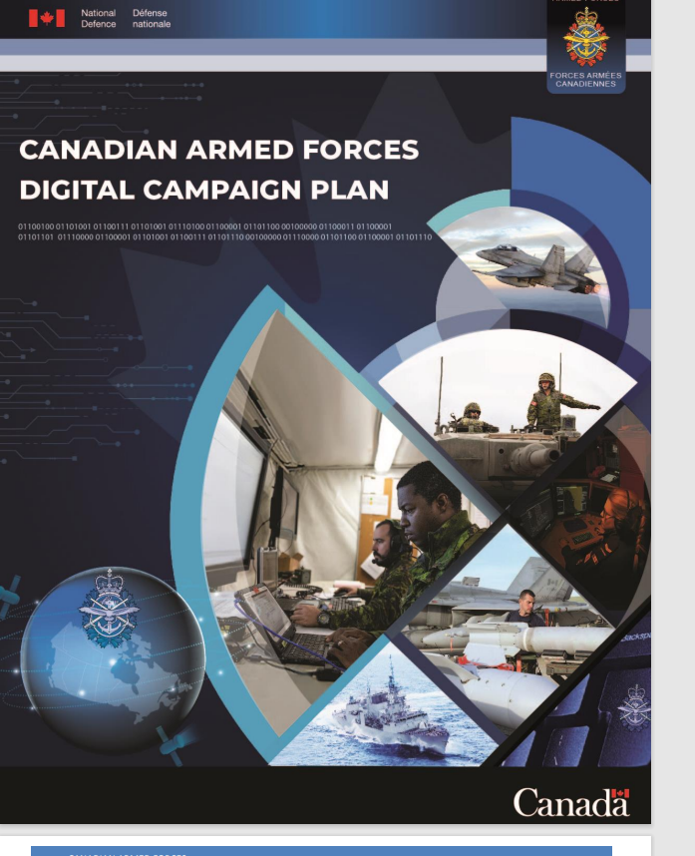
Our partners and allies are all undergoing rapid digital transformation. We must do so as well. Most CAF operations are conducted as part of an alliance or coalition, in concert with partners and allies, or in support of domestic civil authorities. This fact continues to drive our imperative to remain interoperable with the United States (US), Five Eyes (FVEY), North Atlantic Treaty Organization (NATO), domestic Departments and Agencies, and civilian authorities. Moreover, the CAF faces a considerable opportunity and the potential to demonstrate leadership within NORAD, among our allies, and in NATO. The CAF has comparative advantages in leading and coordinating multi-national and Pan-Domain operations, and unleashing these capacities through the adoption of a digital approach will afford us the opportunity to provide digital operational leadership where we enable allies to plug-in. If we do not capitalize on this opportunity, or if we fail to remain interoperable, we may find ourselves unable to make viable and valued contributions to collective efforts to counter our adversaries

Slide 3



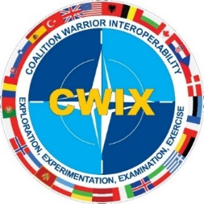

Canadian Cyber Allied Engagement
FVEYs
Defence Cyber Contact Group (DCCG)
Wargame WG
Multinational Framework WG
Policy & Legal WG
Capability Development WG
Cyber Mission Assurance WG
Workforce and Training WG
Multinational Cyber Engagement Group (MCEG)
NATO
NATO Cyberspace Operations Centre (CyOC)
NATO Cyber Commanders’ Forum
Cooperative Cyber Defence Centre of Excellence (CCDCoE) – Tallinn, Estonia
Multinational Cyber Defence Capability Development (MN(CD)2)
Cyber Information and Incident Coordination System (CIICS)
Malware Information Sharing Platform (MISP)
NORAD
NORAD Joint Cyber Centre (JCC)
Defence NORAD Steering Committee (DNSC)
Multinational Capability Development Campaign (MCDC)
Coalition Wide Interoperability Exercise (CWIX)
+ Others (IADB, etc.)

Slide 4

CAFJ6/CIO International Engagements
CAN-US
Combined Defense Information Management Panel (CDIMP)
Canada-US Defence Communications MOU & Arrangements (CAs & IAs)
Mission Partner Environment (MPE) Secret & Below Releasable Network (SABRE)
Joint All Domain Command & Control (JADC2)
NORAD-NORTHCOM projects – CANUS Transport (Big Pipes), SIPR Rel 2FA, CVoIP, SIEG v2
FVEYs
Defence Chief Information Officers’ Forum (DCIOF)
Combined Communications Electronics Board (CCEB) Principal and Executive Group (EG)
12+ CCEB WGs, including Allied Communications Publications (ACPs) and Spectrum Management
Pegasus Program Board (P2B) and Executive (PPE)
Programme Management Function (PMF) and C4I Service Operations Group (CSOG)
NATO
NATO Command, Control, and Consultation Board (C3B)
Capability Panels (4), numerous Capability Teams (5-10 each), including JTDL and Spectrum
ACP and CIS related STANAG coordination meetings
NATO Training Course coordination
NATO C4ISR MOU with NATO Comms & Info Agency (NCIA)
Federated Mission Networking (FMN) with Management, WGs & Teams (8)
Tide Sprint, Coordination with Canadian Deployable Mission Network (CDMN)
Coalition Interoperability WG (CIWG) for CAN national coordination
+ Others - World Radiocommunications Conf. (WRC), Link 16 Multinational WG, Link 22 WGs, MIDS Int’l review Board

Slide 5
Discussion
&
Questions

